Slide 1
IVCSD 26-27 Preliminary Budget Overview

Slide 2
Summary
Revenue - $2,374,479
Expenses - $2,477,729
Surplus/Deficit - ($103,252)
Approve Preliminary Budget June 23 2026, Final Budget August 11, 2026

Slide 3
Scenarios
 | Status Quo | SQ + Soltopia + Parking + Outreach FT | SQ + Parking, No Soltopia or Outreach | SQ + Soltopia + Outreach, No Parking | SQ + Outreach + Parking, No Soltopia
Deficit | -$1,265 | -$100,000 operating + $50,000 for stage from capital reserves + $80,000 for parking from parking reserve + 15,000 for cliff memorial | -$1,388, + 80k for parking + 50k for stage | -$90,000 operating deficit + $50,000 for stage one time | -$48,000
Ending Fund Balance | $1,842,023 | $ 1,623,807 | $ 1,711,890 | $1,703,940 | $ 1,664,807

Slide 4
26-27 Budget - Revenue

Slide 5
Revenue Details
Utility Tax 8% $1.4m
  Water
  Gas
  Electricity
  Trash
  Sewage
UCSB Contribution - $200k
Reservations - $30k
Reserve Withdrawal
Sales - $5k
Sponsorships - $5k
Grants

Slide 6
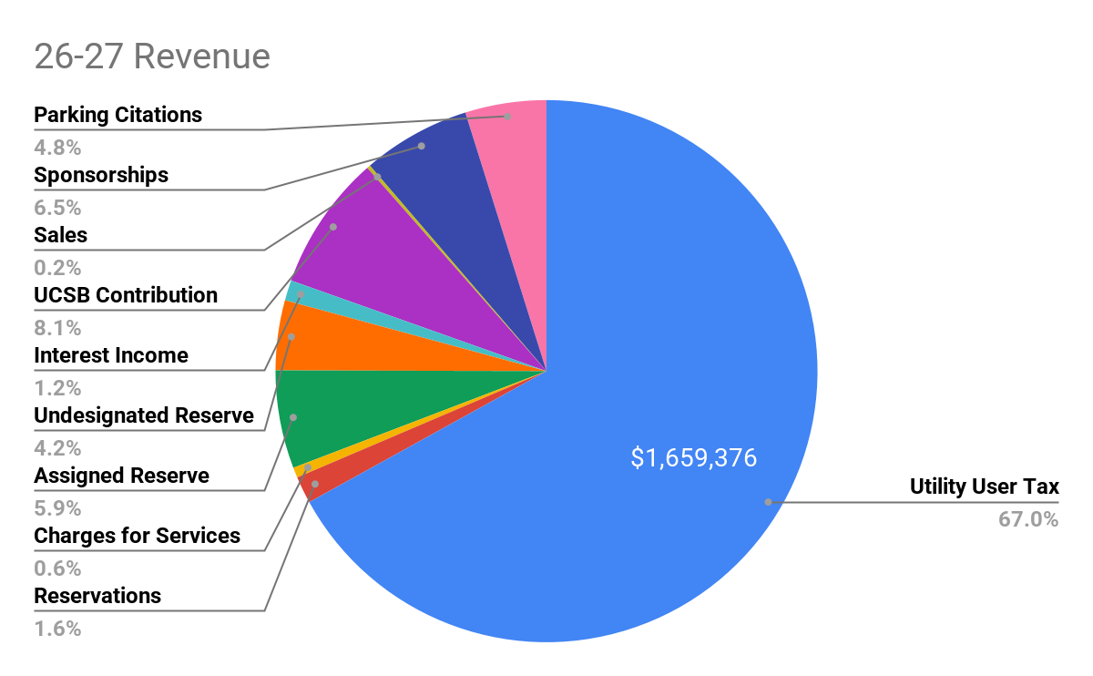

Slide 7
26-27 Budget - Expenses

Slide 8
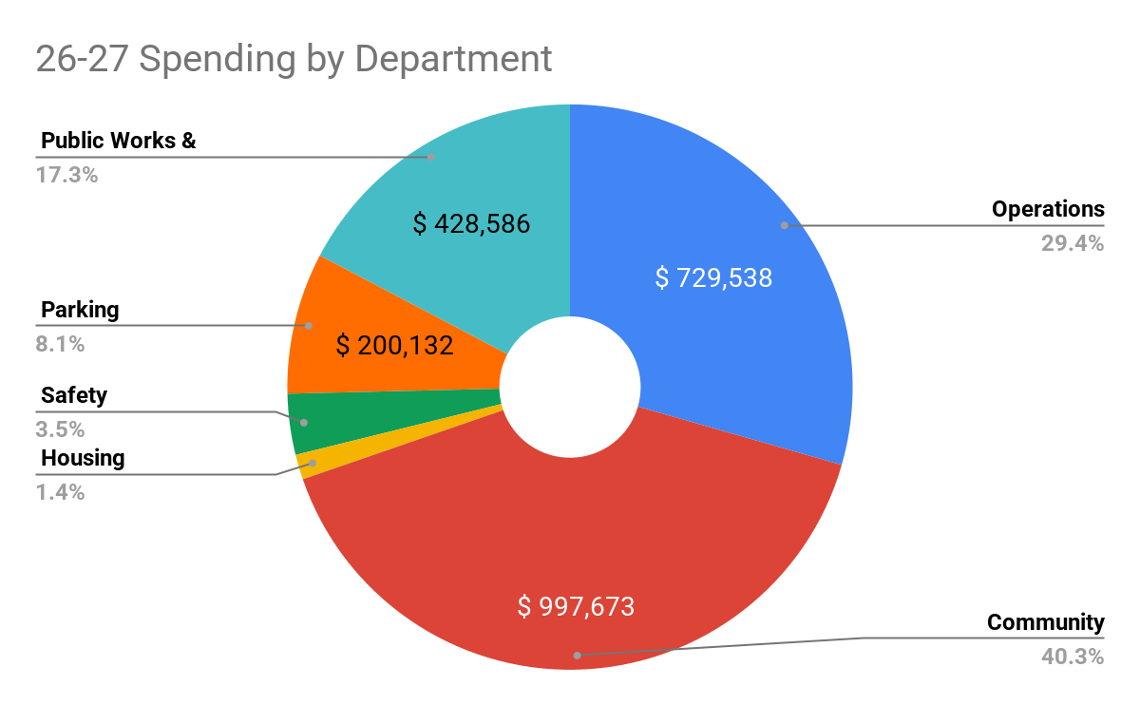
25-26 Spending by Area/Department

Slide 9
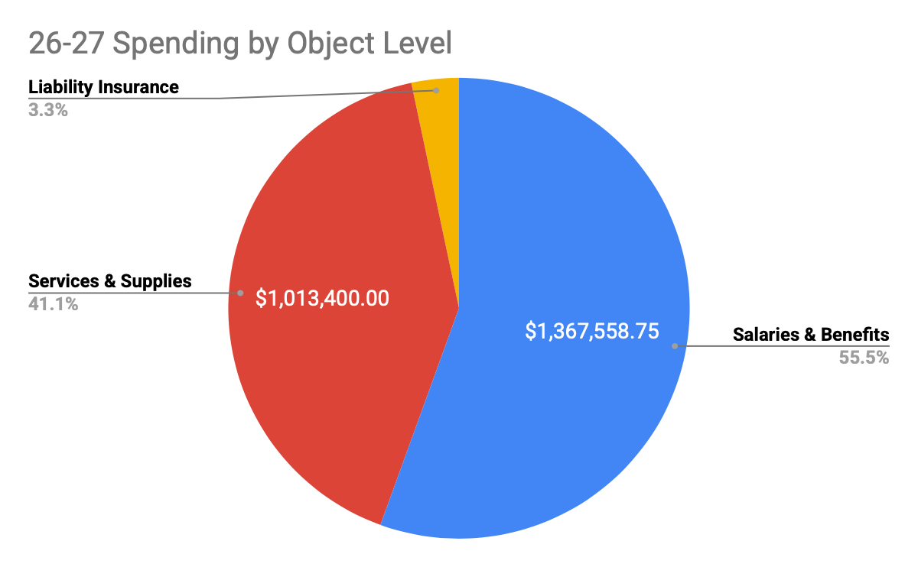

Slide 10
Operations - $729,538
Board compensation
General Manager
Assistant General Manager
Government Administration Intern
District Accountant
District Counsel
Insurance & Workers Compensation
Administrative costs (Zoom, Trello, ADP)
Training
Office costs

Slide 11
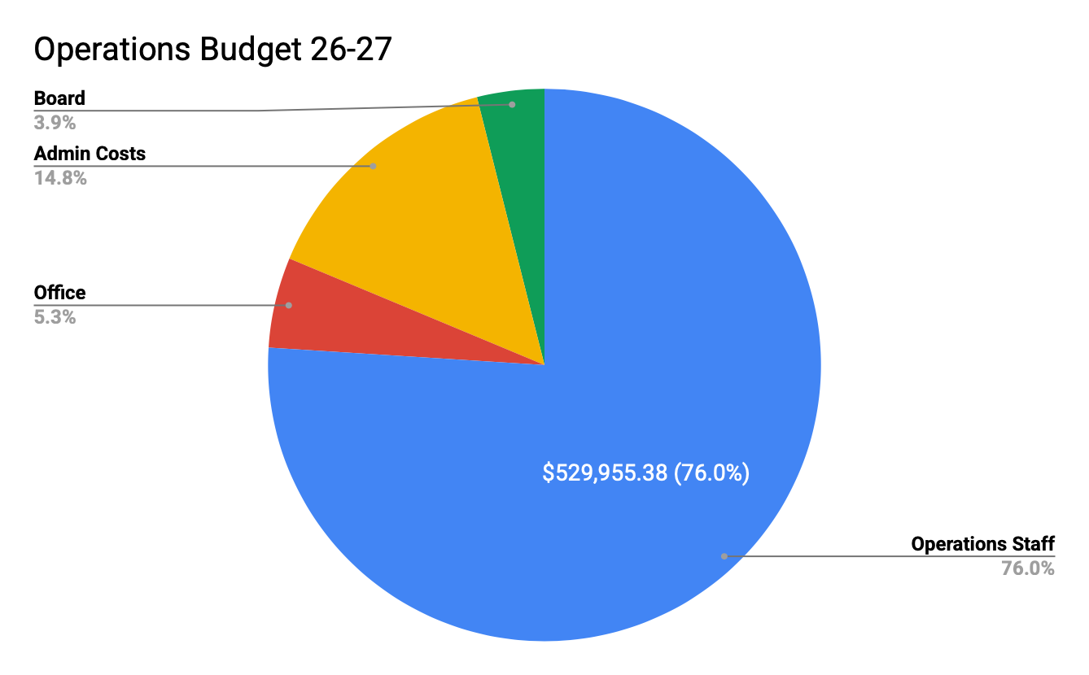

Slide 12
Community Programs & Engagement - $997,673
Community Programs & Engagement Director
Community Spaces Project Manager
Community Engagement Project Manager
Community Engagement Intern
Routine Event Support Contract
District Marketing & Engagement
Community Leadership Initiative & Community Ambassador Program
Spring & Halloween Festival
Community Events & Classes
Community Gardens
Health & Safety Vending Machine

Slide 13
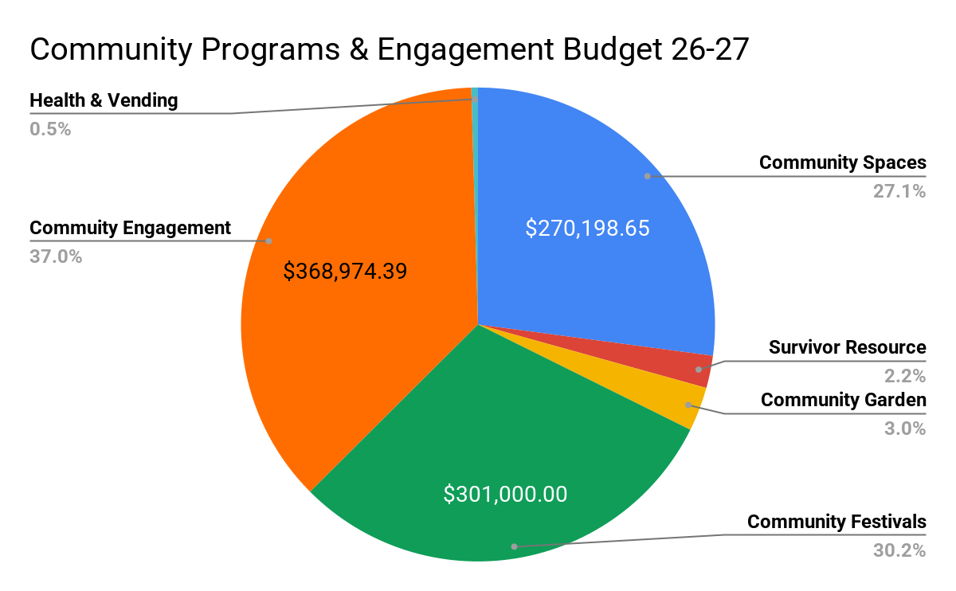

Slide 14
Public Works & Sustainability - $628,718
Public Works & Sustainability Director
Waste Reduction & Diversion Program Manager
Compost Operations Project Manager
Beautification Crew
Composting Crew
Move Out Crew
Power washing
Tree Distribution Program
Lighting Distribution Program
Bike Fleet Maintenance & Storage

Slide 15
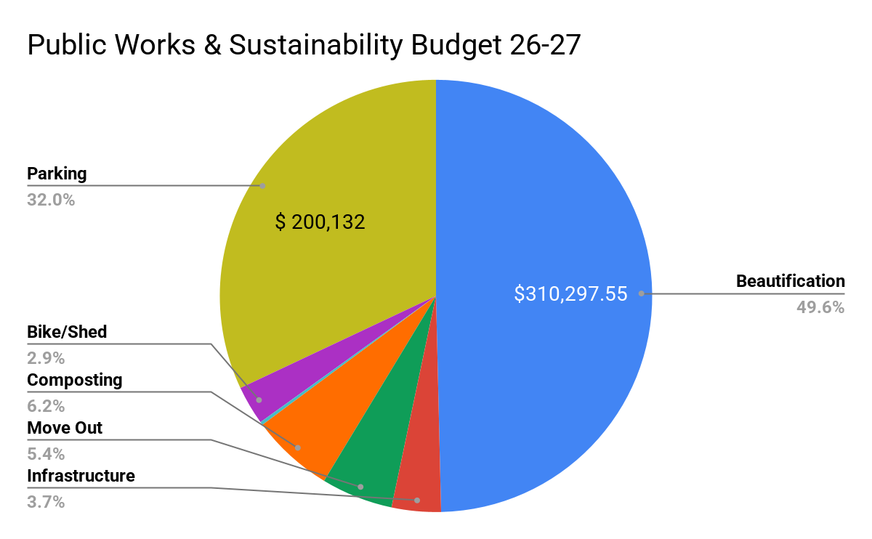

Slide 16
Housing - $35,500
Housing Mediators
Legal Advisors
Marketing

Slide 17
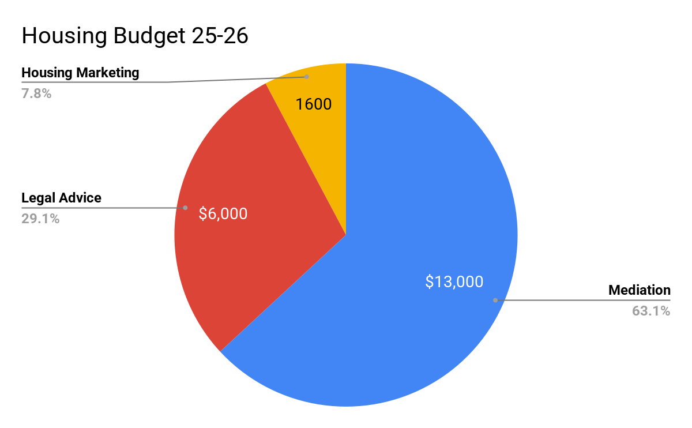
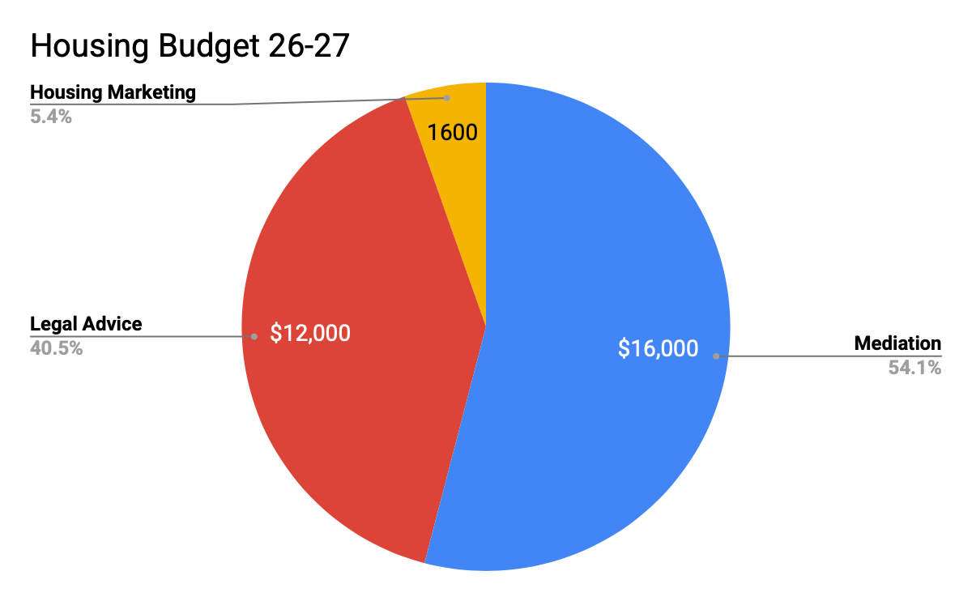

Slide 18
Safety - $86,300
3 Safety Stations
IV Safe - 4 meetings

Slide 19
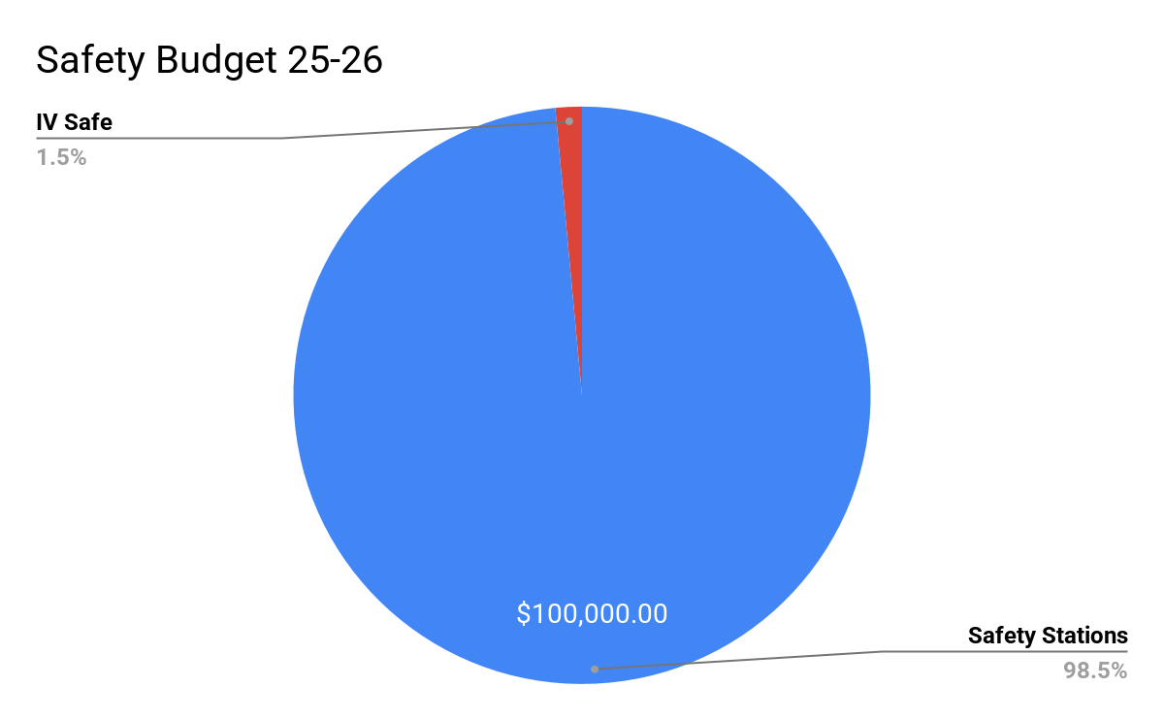
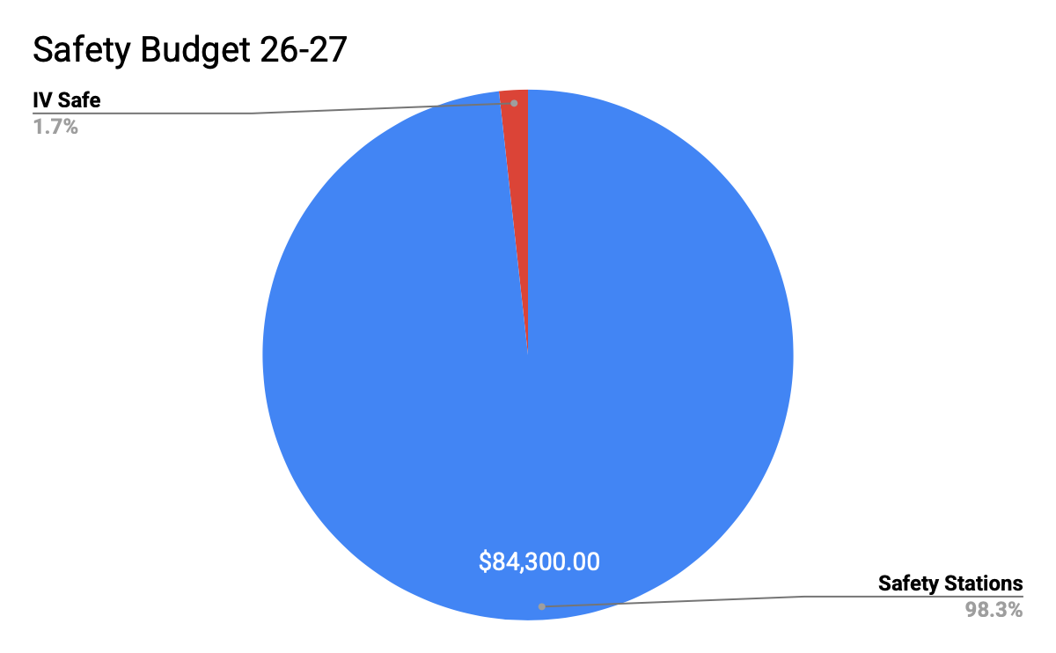

Slide 20
Fund Balance

Slide 21
Utilization of Fund Balance 26-27
$103,000 from undesignated and strategic reserve
$80,000 from Parking Reserve ($50k operating, $30k one time consult
$50,000 from Capital Reserve for IV Community Center improvements
$15,000 from Capital Reserve for cliff fall memorial

Slide 22
 | Year End 17-18 | Year End 18-19 | Year End 19-20 | Year End 20-21 | Year End 21-22 | Year End 22-23 | Year End 23-24 | Year End 24-25 | Year End 25-26 | Year End 26-27
Fund Balance - Total | $57,780 | $575,762 | $1,072,436 | $1,631,015 | $1,954,436 | $2,195,303 | $1,967,238 | $1,843,278 | $1,851,278 | $1,601,311
Assigned Fund Balance | $50,726 | $59,664 | $76,761 | $112,014.66 | $59,140 | $27,457 | $61,274 | $263,000 | $250,000 | $170,000
Mediation Program | $26,828 | $26,856 | $21,489 | $21,489 | $21,489 | $20,162 | $18,921 | $18,921 | $0.00 | 0
Safety Stations | $18,898 | $18,862 | $15,907 | $21,834 | $37,651 | $7,296 | $41,411 | $41,411
Graffiti Abatement | $5,000 | $8,000 | $0 | $0 | $0 | $0 | $0
Internship | $0 | $5,946 | $0 | $0 | $0 | $0 | $0
Interpersonal Investigator | $0 | $0 | $0 | $31,423 | $0 | $0 | $942 | $942
Move Out
Parking |  |  |  |  |  |  |  | $250,000 | $250,000 | $170,000
ASUCSB Compost Grant |  |  | $39,366 | $37,268 | $0 | $0 | $0
Restricted | $0 | $1,845 | $1,773 | $480.22 | $0.000 | $0.00 | $0.00 | $0.00 | $0.00 | 0
CSD Committed Fund Balance + Undesignated Fund Balance | $7,054 | $514,253 | $993,901 | $1,518,520 | $1,895,296 | $2,167,846 | $1,905,964 | $1,532,005 | $1,601,278 | $1,431,311
Short term strategic 9840 | $0 | $140,000 | $140,000 | $140,000.00 | $168,000.00 | $0.00 | $0.00 | $0.00 | $0.00
Capital Maintenance of Structures and Equipment - 9851 | $0 | $56,000 | $56,000 | $56,000 | $73,000 | $73,405 | $110,498 | $96,777 | $100,434 | $123,886
Self Insurance 9845 | $0 | $111,000 | $111,000 | $111,000 | $146,000 | $146,810 | $220,997 | $193,554 | $200,867 | $247,773
Accumulative Capital Outlay - 9830 | $0 | $207,253 | $304,000 | $354,000 | $307,000 | $406,260 | $403,572 | $426,159 | $459,000 | $497,813
Long term strategic 9840 | $0 | $0 | $281,000 | $281,000 | $336,000 | $677,100 | $672,620 | $714,058 | $765,000 | $561,839
Total CSD Committed Fund Balance | $0 | $514,253 | $892,000 | $942,000 | $1,030,000 | $1,303,575 | $1,407,687 | $1,142,493 | $1,525,301 | $1,431,311
CSD Undesignated Fund Balance | $7,054 | $0 | $101,901 | $576,520.12 | $865,295.82 | $864,271 | $498,277 | $389,511 | $75,977 | 0

Slide 23
